Slide 1



Slide 2
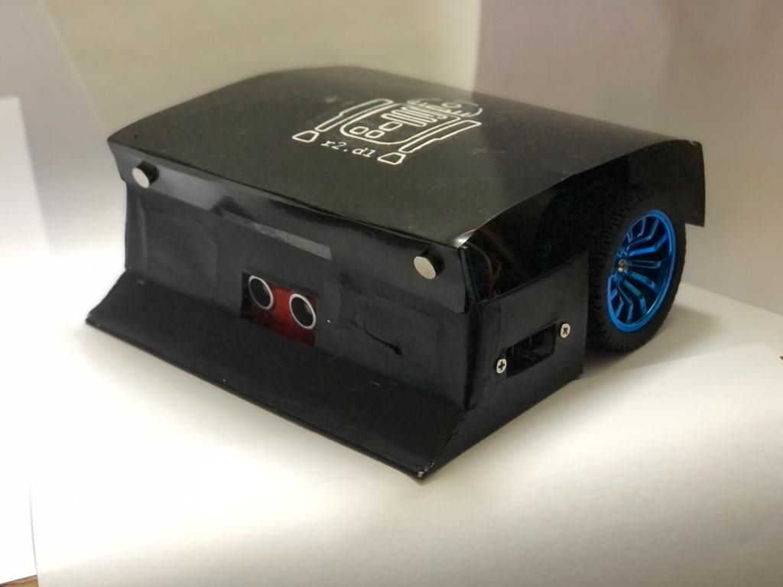

Slide 3


Slide 4
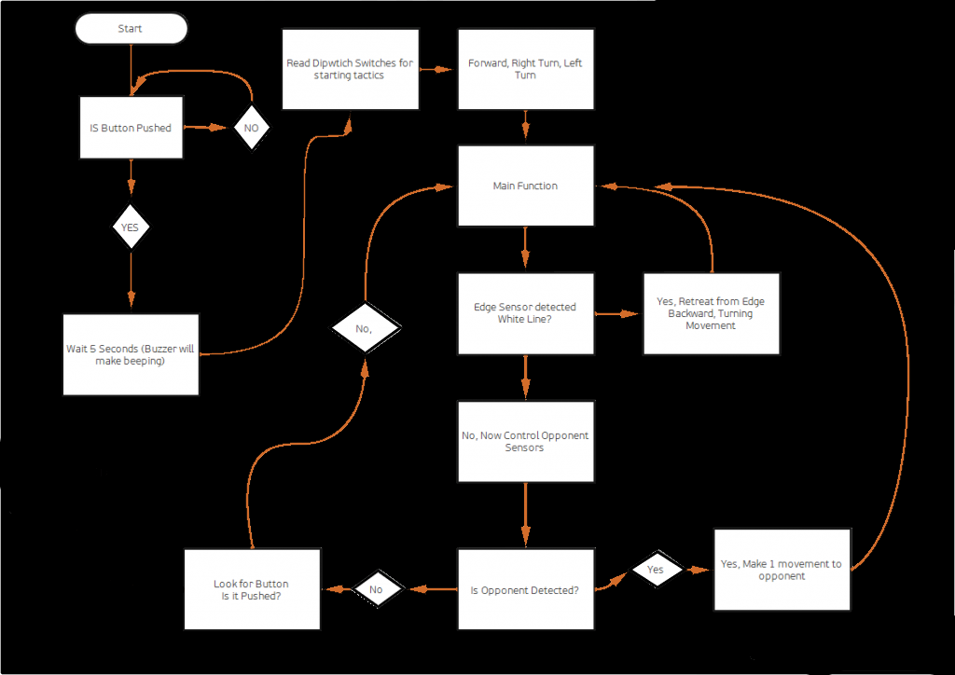


Slide 6
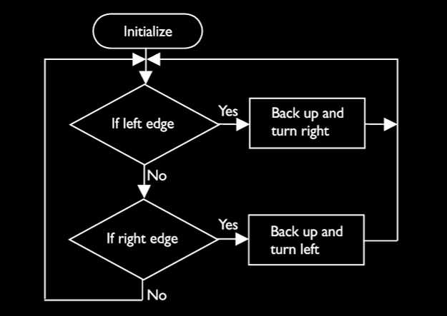

SUMO

Slide 7
SUMO

Slide 9
Presented by
Rishabh
Daniel
Ryan

